Slide 1
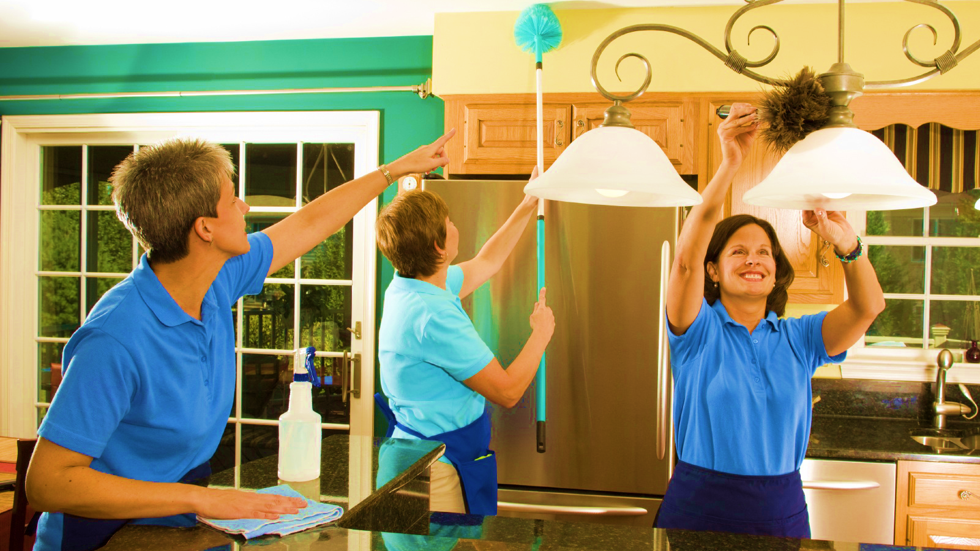
LOWES
PRO SERVICES

Slide 2
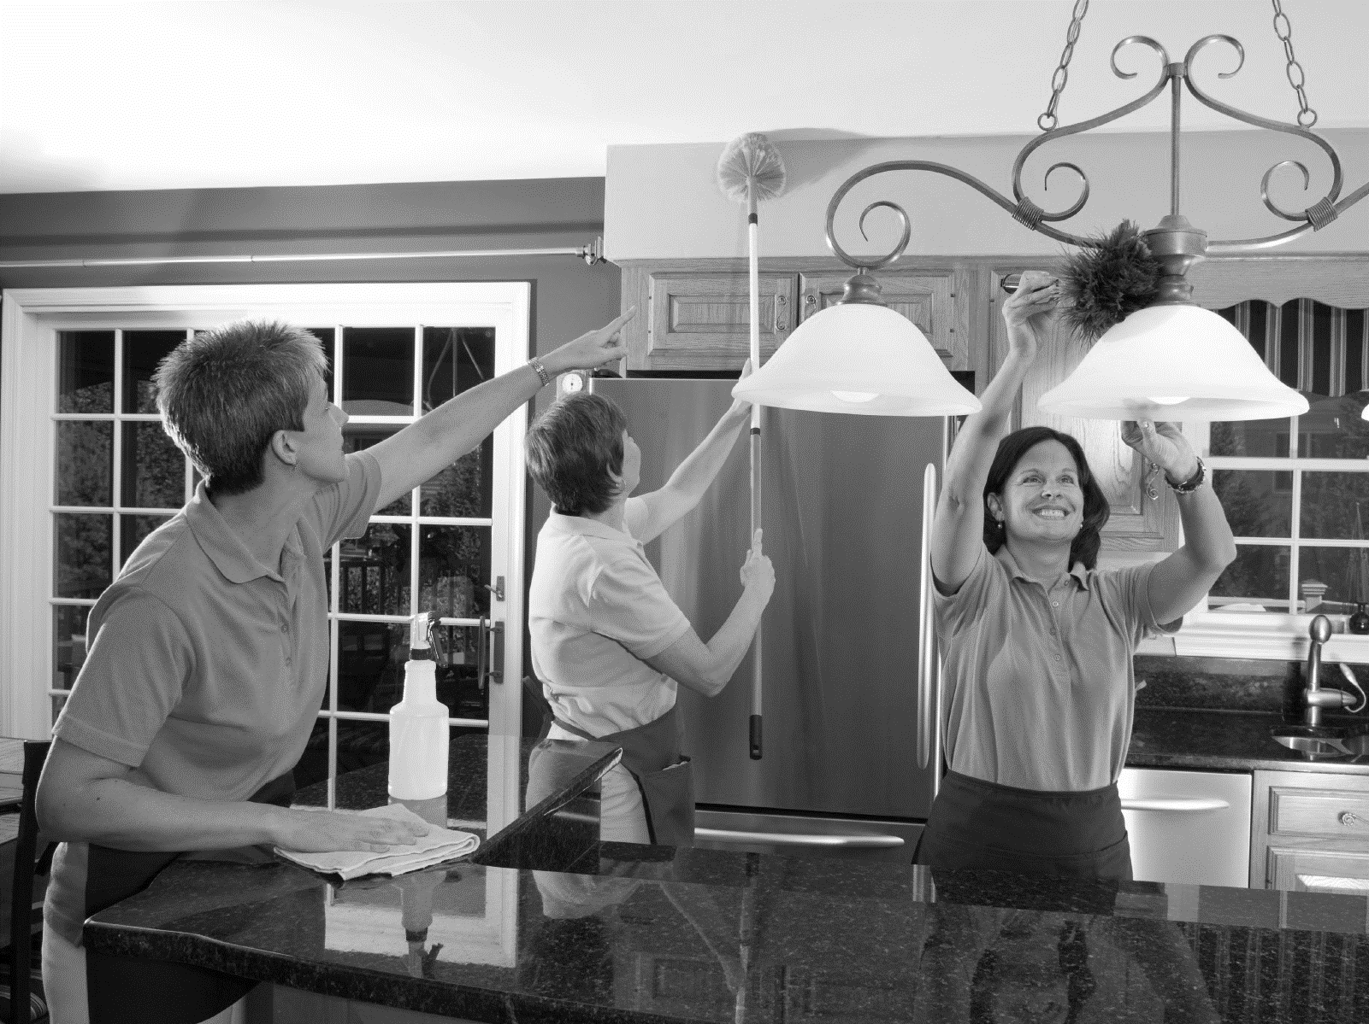



Major Purchasing decisions are influenced by the quality of the After Sales Services
Customer Influences
Ease of installation and procurement of reliable installation services top the list
Installers can not only cross-sell and Upsell but also increase customer retention

Slide 3
INSTALLATION SERVICES- At a Glance

Slide 4
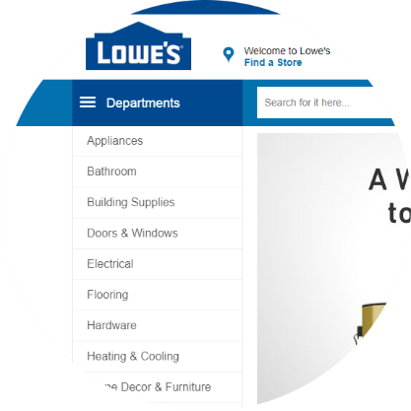



ON THE WEB
ON THE FLOOR
CUSTOMER REQUESTS THE SERVICE VIA THE WEBSITE
LOWES RECEIVES CUSTOMER INFORMATION AND CONTACTS THEM Offline
CUSTOMER REQUESTS RECCOMENDATION FOR INSTALLATION SERVICES
LOWES MAY NOT HAVE AN ACREDITED LIST OF CONTRACTORS for the job

Slide 5




Customer leaves the Lowes portal, looks for similar services in competitors websites (eg. home depot, Angies list, Amazon)
Competition offers services that are on demand and satisfies the customers immediate need
Business Impact
Lowes incurs loss from missed commissions, upselling and cross selling opportunities
Disconnected customers, Lost customer Loyalty, Missed Opportunities

Slide 6

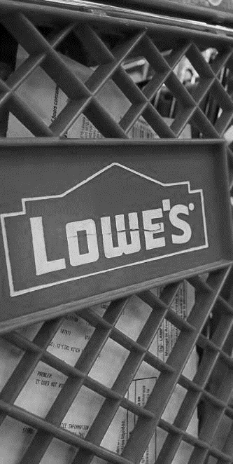



Build rock solid base of prosumers
Attract customers in the first instance
DESIRED OUTCOME
Increase prospects
How do we get there???

Slide 7
Our Solution:
Customer Process Flow

Slide 8
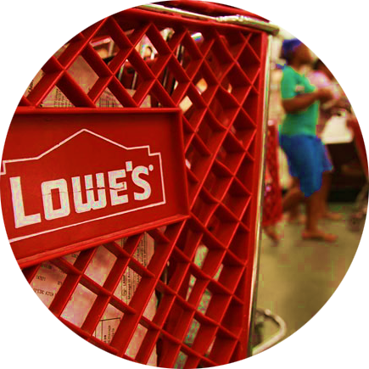

1
CUSTOMER BUYS A BIG TICKET ITEM FROM STORE
2
CSR IDENTIFIES THE CUSTOMER AS A CONSUMER OR SERVICE PROVIDER (Prosumer)

Slide 9
Our Solution:
Prosumer Process Flow

Slide 10




SERVICE PROVIDER
CONSUMER
4
RECOMMEND THAT THEY JOIN THE LOWES PROSERVICES TEAM
3
RECOMMEND INSTALLATION SERVICES USING A LOWE'S PRO

Slide 11
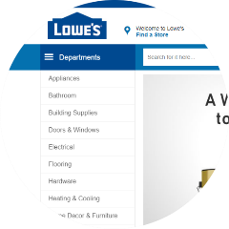


1
CONSUMER BUYS ITEM FROM WEB SITE
3
IF PROSUMER, THEN RECOMMEND THAT HE JOIN THE LOWES PROSERVICES TEAM
2
DEPENDING ON CONTEXT, A PROFESSIONAL SERVICE IS RECOMMENDED

Slide 12
One Stop Solution
To
Bridge the gaps

Slide 13





Prosumer Engagement & Onboarding
Store and Ecommerce portal
LOWESPro Connect
Personal Verification
Background check
Face to face training on acceptable service standards

Slide 14
THANK YOU

